Slide 1
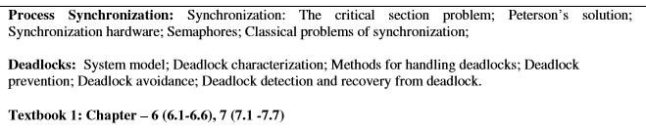
Module 3

Slide 2
Background
Concurrent access to shared data may result in data inconsistency
Maintaining data consistency requires mechanisms to ensure the orderly execution of cooperating processes
Suppose that we wanted to provide a solution to the consumer-producer problem that fills all the buffers. We can do so by having an integer count that keeps track of the number of full buffers. Initially, count is set to 0. It is incremented by the producer after it produces a new buffer and is decremented by the consumer after it consumes a buffer.

Slide 3
Producer
Consumer
while (true) {
/* produce an item and put in nextProduced */
while (count == BUFFER_SIZE)
; // do nothing
buffer [in] = nextProduced;
in = (in + 1) % BUFFER_SIZE;
count++;
}
while (true) {
while (count == 0)
; // do nothing
nextConsumed = buffer[out];
out = (out + 1) % BUFFER_SIZE;
count--;
/* consume the item in nextConsumed
}

Slide 4
Race Condition
count++ could be implemented as
register1 = count
register1 = register1 + 1
count = register1
count-- could be implemented as
register2 = count
register2 = register2 - 1
count = register2
Consider this execution interleaving with “count = 5” initially:
  S0: producer execute register1 = count {register1 = 5}
  S1: producer execute register1 = register1 + 1 {register1 = 6}
  S2: consumer execute register2 = count {register2 = 5}
  S3: consumer execute register2 = register2 - 1 {register2 = 4}
  S4: producer execute count = register1 {count = 6 }
  S5: consumer execute count = register2 {count = 4}

Slide 5
Solution to Critical-Section Problem
1. Mutual Exclusion - If process P_{i} is executing in its critical section, then no other processes can be executing in their critical sections
2. Progress - If no process is executing in its critical section and there exist some processes that wish to enter their critical section, then the selection of the processes that will enter the critical section next cannot be postponed indefinitely
3. Bounded Waiting - A bound must exist on the number of times that other processes are allowed to enter their critical sections after a process has made a request to enter its critical section and before that request is granted
  Assume that each process executes at a nonzero speed
  No assumption concerning relative speed of the N processes

Slide 6
Solution to Critical-section Problem Using Locks
do {
acquire lock
critical section
release lock
remainder section
} while (TRUE);

Slide 7
Peterson’s Solution
Two process solution
Assume that the LOAD and STORE instructions are atomic; that is, cannot be interrupted.
The two processes share two variables:
  int turn;
  Boolean flag[2]
The variable turn indicates whose turn it is to enter the critical section.
The flag array is used to indicate if a process is ready to enter the critical section. flag[i] = true implies that process P_{i} is ready!

Slide 8
Algorithm for Process P_{i}
do {
flag[i] = TRUE;
turn = j;
while (flag[j] && turn == j);
critical section
flag[i] = FALSE;
remainder section
} while (TRUE);

Slide 9
Synchronization Hardware
Many systems provide hardware support for critical section code
Uniprocessors – could disable interrupts
  Currently running code would execute without preemption
  Generally too inefficient on multiprocessor systems
    Operating systems using this not broadly scalable
Modern machines provide special atomic hardware instructions
    Atomic = non-interruptable
  Either test memory word and set value
  Or swap contents of two memory words

Slide 10
TestAndndSet Instruction
Definition:
boolean TestAndSet (boolean *target)
{
boolean rv = *target;
*target = TRUE;
return rv:
}

Slide 11
Solution using TestAndSet
Shared boolean variable lock., initialized to false.
Solution:
do {
while ( TestAndSet (&lock ))
; // do nothing
// critical section
lock = FALSE;
// remainder section
} while (TRUE);

Slide 12
Swap Instruction
Definition:
void Swap (boolean *a, boolean *b)
{
boolean temp = *a;
*a = *b;
*b = temp:
}

Slide 13
Bounded-waiting Mutual Exclusion with TestandSet()
do {
waiting[i] = TRUE;
key = TRUE;
while (waiting[i] && key)
key = TestAndSet(&lock);
waiting[i] = FALSE;
// critical section
j = (i + 1) % n;
while ((j != i) && !waiting[j])
j = (j + 1) % n;
if (j == i)
lock = FALSE;
else
waiting[j] = FALSE;
// remainder section
} while (TRUE);

Slide 14
Semaphore
Synchronization tool that does not require busy waiting
Semaphore S – integer variable
Two standard operations modify S: wait() and signal()
  Originally called P() and V()
Less complicated
Can only be accessed via two indivisible (atomic) operations
  wait (S) {
  while S <= 0
  ; // no-op
  S--;
  }
  signal (S) {
  S++;
  }

Slide 15
Semaphore as General Synchronization Tool
Counting semaphore – integer value can range over an unrestricted domain
Binary semaphore – integer value can range only between 0
and 1; can be simpler to implement
  Also known as mutex locks
Can implement a counting semaphore S as a binary semaphore
Provides mutual exclusion
  Semaphore mutex; // initialized to 1
  do {
  wait (mutex);
  // Critical Section
  signal (mutex);
  // remainder section
  } while (TRUE);

Slide 16
Semaphore Implementation
Must guarantee that no two processes can execute wait () and signal () on the same semaphore at the same time
Thus, implementation becomes the critical section problem where the wait and signal code are placed in the crtical section.
  Could now have busy waiting in critical section implementation
    But implementation code is short
    Little busy waiting if critical section rarely occupied
Note that applications may spend lots of time in critical sections and therefore this is not a good solution.

Slide 17
Semaphore Implementation with no Busy waiting
With each semaphore there is an associated waiting queue. Each entry in a waiting queue has two data items:
  value (of type integer)
  pointer to next record in the list
Two operations:
  block – place the process invoking the operation on the appropriate waiting queue.
  wakeup – remove one of processes in the waiting queue and place it in the ready queue.

Slide 18
Semaphore Implementation with no Busy waiting (Cont.)
Implementation of wait:
wait(semaphore *S) {
S->value--;
if (S->value < 0) {
add this process to S->list;
block();
}
}
Implementation of signal:
signal(semaphore *S) {
S->value++;
if (S->value <= 0) {
remove a process P from S->list;
wakeup(P);
}
}

Slide 19
Deadlock and Starvation
Deadlock – two or more processes are waiting indefinitely for an event that can be caused by only one of the waiting processes
Let S and Q be two semaphores initialized to 1
P₀ P₁
wait (S); wait (Q);
wait (Q); wait (S);
. .
. .
. .
signal (S); signal (Q);
signal (Q); signal (S);
Starvation – indefinite blocking. A process may never be removed from the semaphore queue in which it is suspended
Priority Inversion - Scheduling problem when lower-priority process holds a lock needed by higher-priority process

Slide 20
Classical Problems of Synchronization
Bounded-Buffer Problem
Readers and Writers Problem
Dining-Philosophers Problem

Slide 21
Bounded-Buffer Problem
N buffers, each can hold one item
Semaphore mutex initialized to the value 1
Semaphore full initialized to the value 0
Semaphore empty initialized to the value N.
The structure of the producer process
do {
// produce an item in nextp
wait (empty);
wait (mutex);
// add the item to the buffer
signal (mutex);
signal (full);
} while (TRUE);

Slide 22
Readers-Writers Problem
A data set is shared among a number of concurrent processes
  Readers – only read the data set; they do not perform any updates
  Writers – can both read and write
Problem – allow multiple readers to read at the same time. Only one single writer can access the shared data at the same time
Shared Data
  Data set
  Semaphore mutex initialized to 1
  Semaphore wrt initialized to 1
Integer readcount initialized to 0
The structure of a writer process
do {
wait (wrt) ;
// writing is performed
signal (wrt) ;
} while (TRUE);

Slide 23
Readers-Writers Problem (Cont.)
The structure of a reader process
do {
wait (mutex) ;
readcount ++ ;
if (readcount == 1)
wait (wrt) ;
signal (mutex)
// reading is performed
wait (mutex) ;
readcount - - ;
if (readcount == 0)
signal (wrt) ;
signal (mutex) ;
} while (TRUE);

Slide 24
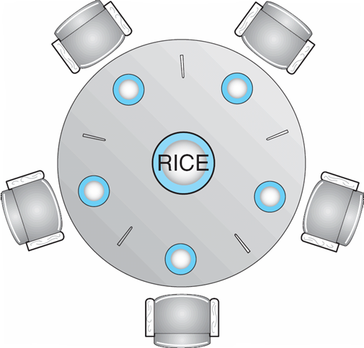
Dining-Philosophers Problem
The structure of Philosopher i:
    do {
    wait ( chopstick[i] );
    wait ( chopStick[ (i + 1) % 5] );
    // eat
    signal ( chopstick[i] );
    signal (chopstick[ (i + 1) % 5] );
    // think
    } while (TRUE);
Shared data
  Bowl of rice (data set)
  Semaphore chopstick [5] initialized to 1

Slide 25
Problems with Semaphores
Incorrect use of semaphore operations:
  signal (mutex) …. wait (mutex)
  wait (mutex) … wait (mutex)
  Omitting of wait (mutex) or signal (mutex) (or both)

Slide 26
Chapter 2: Deadlocks
The Deadlock Problem
A set of blocked processes each holding a resource and waiting to acquire a resource held by another process in the set
Example
  System has 2 disk drives
  P₁ and P₂ each hold one disk drive and each needs another one
Example
  semaphores A and B, initialized to 1
        P₀ P₁
        wait (A); wait(B)
        wait (B); wait(A)

Slide 27
Bridge Crossing Example
Traffic only in one direction
Each section of a bridge can be viewed as a resource
If a deadlock occurs, it can be resolved if one car backs up (preempt resources and rollback)
Several cars may have to be backed up if a deadlock occurs
Starvation is possible
Note – Most OSes do not prevent or deal with deadlocks

Slide 28
System Model
Resource types R₁, R₂, . . ., R_{m}
    CPU cycles, memory space, I/O devices
Each resource type R_{i} has W_{i} instances.
Each process utilizes a resource as follows:
  request
  use
  release

Slide 29
Deadlock Characterization
Deadlock can arise if four conditions hold simultaneously.
Mutual exclusion: only one process at a time can use a resource
Hold and wait: a process holding at least one resource is waiting to acquire additional resources held by other processes
No preemption: a resource can be released only voluntarily by the process holding it, after that process has completed its task
Circular wait: there exists a set {P₀, P₁, …, P_{n}} of waiting processes such that P₀ is waiting for a resource that is held by P₁, P₁ is waiting for a resource that is held by
P₂, …, P_{n–1} is waiting for a resource that is held by P_{n}, and P_{n} is waiting for a resource that is held by P₀.

Slide 30
Resource-Allocation Graph
A set of vertices V and a set of edges E.
V is partitioned into two types:
  P = {P₁, P₂, …, P_{n}}, the set consisting of all the processes in the system
  R = {R₁, R₂, …, R_{m}}, the set consisting of all resource types in the system
request edge – directed edge P_{i} → R_{j}
assignment edge – directed edge R_{j} → P_{i}
Process
Resource Type with 4 instances
P_{i} requests instance of R_{j}
P_{i} is holding an instance of R_{j}
P_{i}
P_{i}

Slide 31
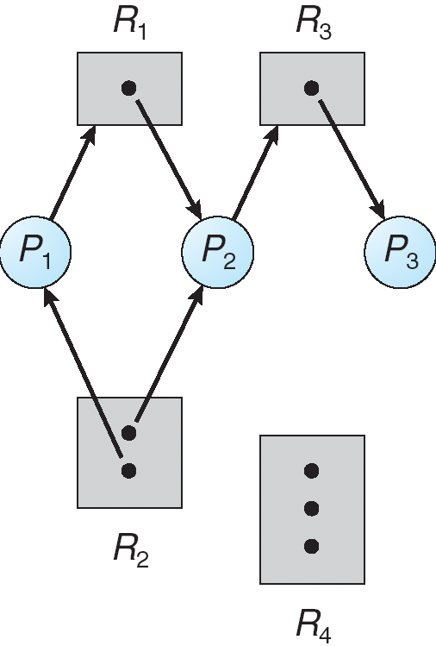
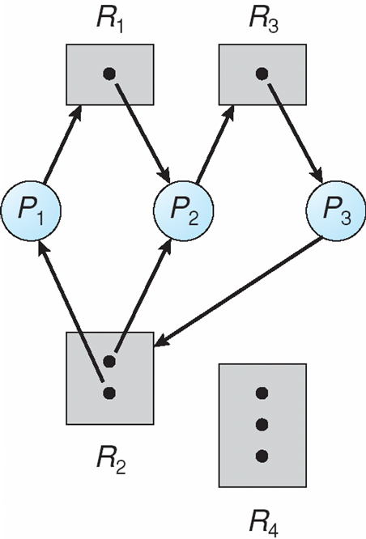
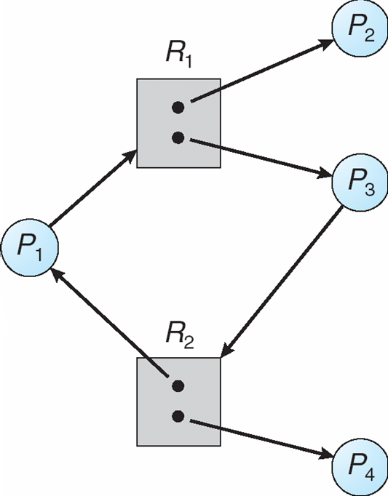
Example of a Resource Allocation Graph
Resource Allocation Graph With A Deadlock
Graph With A Cycle But No Deadlock

Slide 32
Basic Facts
If graph contains no cycles ⇒ no deadlock
If graph contains a cycle ⇒
  if only one instance per resource type, then deadlock
  if several instances per resource type, possibility of deadlock

Slide 33
Methods for Handling Deadlocks
Ensure that the system will never enter a deadlock state
Allow the system to enter a deadlock state and then recover
Ignore the problem and pretend that deadlocks never occur in the system; used by most operating systems, including UNIX

Slide 34
Deadlock Prevention
Restrain the ways request can be made
Mutual Exclusion – not required for sharable resources; must hold for non-sharable resources
Hold and Wait – must guarantee that whenever a process requests a resource, it does not hold any other resources
  Require process to request and be allocated all its resources before it begins execution, or allow process to request resources only when the process has none
  Low resource utilization; starvation possible
No Preemption –
  If a process that is holding some resources requests another resource that cannot be immediately allocated to it, then all resources currently being held are released
  Preempted resources are added to the list of resources for which the process is waiting
  Process will be restarted only when it can regain its old resources, as well as the new ones that it is requesting
Circular Wait – impose a total ordering of all resource types, and require that each process requests resources in an increasing order of enumeration

Slide 35
Deadlock Avoidance
Requires that the system has some additional a priori information available
Simplest and most useful model requires that each process declare the maximum number of resources of each type that it may need
The deadlock-avoidance algorithm dynamically examines the resource-allocation state to ensure that there can never be a circular-wait condition
Resource-allocation state is defined by the number of available and allocated resources, and the maximum demands of the processes

Slide 36
Safe State
When a process requests an available resource, system must decide if immediate allocation leaves the system in a safe state
System is in safe state if there exists a sequence <P₁, P₂, …, P_{n}> of ALL the processes is the systems such that for each P_{i}, the resources that P_{i} can still request can be satisfied by currently available resources + resources held by all the P_{j}, with j < i
That is:
  If P_{i} resource needs are not immediately available, then P_{i} can wait until all P_{j} have finished
  When P_{j} is finished, P_{i} can obtain needed resources, execute, return allocated resources, and terminate
  When P_{i} terminates, P_{i +1} can obtain its needed resources, and so on

Slide 37
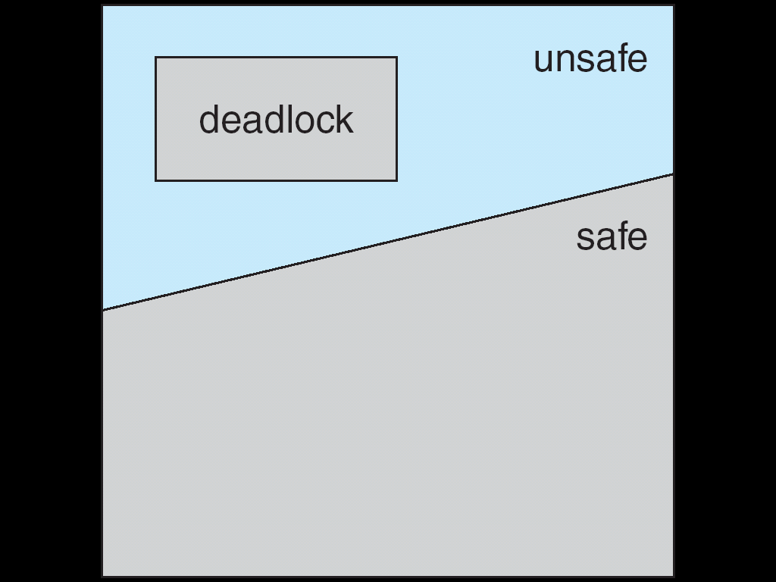
Basic Facts
If a system is in safe state ⇒ no deadlocks
If a system is in unsafe state ⇒ possibility of deadlock
Avoidance ⇒ ensure that a system will never enter an unsafe state.
Safe, Unsafe , Deadlock State

Slide 38
Avoidance algorithms
Single instance of a resource type
  Use a resource-allocation graph
Multiple instances of a resource type
  Use the banker’s algorithm

Slide 39
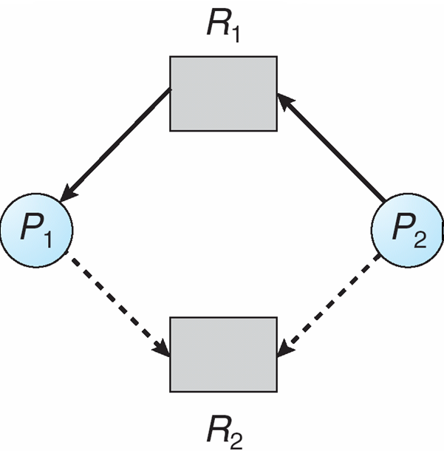
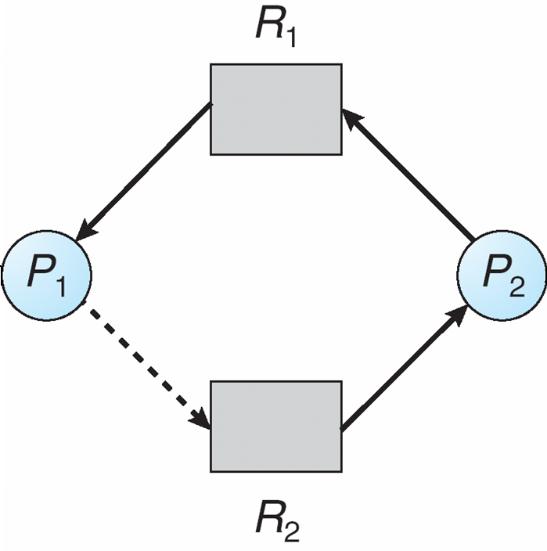
Resource-Allocation Graph Scheme
Claim edge P_{i} → R_{j} indicated that process P_{j} may request resource R_{j}; represented by a dashed line
Claim edge converts to request edge when a process requests a resource
Request edge converted to an assignment edge when the resource is allocated to the process
When a resource is released by a process, assignment edge reconverts to a claim edge
Resources must be claimed a priori in the system
Resource-Allocation Graph
Unsafe State In Resource-Allocation Graph

Slide 40
Resource-Allocation Graph Algorithm
Suppose that process P_{i} requests a resource R_{j}
The request can be granted only if converting the request edge to an assignment edge does not result in the formation of a cycle in the resource allocation graph

Slide 41
Banker’s Algorithm
Multiple instances
Each process must a priori claim maximum use
When a process requests a resource it may have to wait
When a process gets all its resources it must return them in a finite amount of time

Slide 42
Data Structures for the Banker’s Algorithm
Let n = number of processes, and m = number of resources types.
Available: Vector of length m. If available [j] = k, there are k instances of resource type R_{j} available
Max: n x m matrix. If Max [i,j] = k, then process P_{i} may request at most k instances of resource type R_{j}
Allocation: n x m matrix. If Allocation[i,j] = k then P_{i} is currently allocated k instances of R_{j}
Need: n x m matrix. If Need[i,j] = k, then P_{i} may need k more instances of R_{j} to complete its task
Need [i,j] = Max[i,j] – Allocation [i,j]

Slide 43
Safety Algorithm
1. Let Finish be vector of length n. Initialize:
      Finish [i] = false for i = 0, 1, …, n- 1
2. Find an i such that both:
  (a) Finish [i] = false
  (b) Need_{i} ≤ Available [j]
  If no such i exists, go to step 4
3. Available [j] = Available [j] + Allocation_{i}
Finish[i] = true
go to step 2
4. If Finish [i] == true for all i, then the system is in a safe state.

Slide 44
Resource-Request Algorithm for Process P_{i}
Request = request vector for process P_{i}. If Request_{i} [j] = k then process P_{i} wants k instances of resource type R_{j}
  1. If Request_{i} ≤ Need_{i} go to step 2. Otherwise, raise error condition, since process has exceeded its maximum claim
  2. If Request_{i} ≤ Available, go to step 3. Otherwise P_{i} must wait, since resources are not available
  3. Pretend to allocate requested resources to P_{i} by modifying the state as follows:
      Available = Available – Request;
      Allocation_{i} = Allocation_{i} + Request_{i};
      Need_{i} = Need_{i} – Request_{i};
    If safe ⇒ the resources are allocated to Pi
    If unsafe ⇒ Pi must wait, and the old resource-allocation state is restored

Slide 45
Example of Banker’s Algorithm
5 processes P₀ through P₄;
3 resource types:
A (10 instances), B (5instances), and C (7 instances)
Snapshot at time T₀:
Allocation Max Available
A B C A B C A B C
P₀ 0 1 0 7 5 3 3 3 2
P₁ 2 0 0 3 2 2
P₂ 3 0 2 9 0 2
P₃ 2 1 1 2 2 2
P₄ 0 0 2 4 3 3

Slide 46
Example (Cont.)
The content of the matrix Need is defined to be Max – Allocation
Need
A B C
P₀ 7 4 3
P₁ 1 2 2
P₂ 6 0 0
P₃ 0 1 1
P₄ 4 3 1
The system is in a safe state since the sequence < P₁, P₃, P₄, P₂, P₀> satisfies safety criteria

Slide 47
Example: P₁ Request (1,0,2)
Check that Request ≤ Available (that is, (1,0,2) ≤ (3,3,2) ⇒ true
Allocation Need Available
A B C A B C A B C
P₀ 0 1 0 7 4 3 2 3 0
P₁ 3 0 2 0 2 0
P₂ 3 0 1 6 0 0
P₃ 2 1 1 0 1 1
P₄ 0 0 2 4 3 1
Executing safety algorithm shows that sequence < P₁, P₃, P₄, P₀, P₂> satisfies safety requirement
Can request for (3,3,0) by P₄ be granted?
Can request for (0,2,0) by P₀ be granted?

Slide 48
Deadlock Detection
Allow system to enter deadlock state
Detection algorithm
Recovery scheme

Slide 49
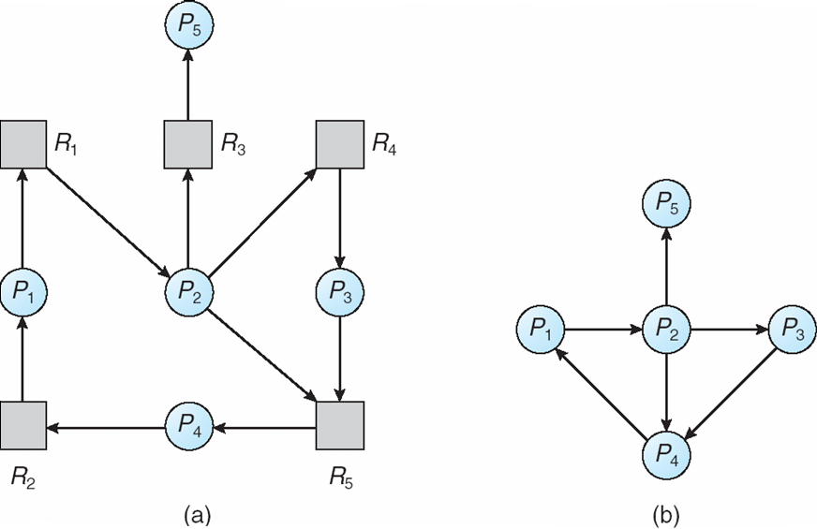
Single Instance of Each Resource Type
Maintain wait-for graph
  Nodes are processes
  P_{i} → P_{j} if P_{i} is waiting for P_{j}
Periodically invoke an algorithm that searches for a cycle in the graph. If there is a cycle, there exists a deadlock
An algorithm to detect a cycle in a graph requires an order of n² operations, where n is the number of vertices in the graph
Resource-Allocation Graph and Wait-for Graph
Resource-Allocation Graph
Corresponding wait-for graph

Slide 50
Several Instances of a Resource Type
Available: A vector of length m indicates the number of available resources of each type.
Allocation: An n x m matrix defines the number of resources of each type currently allocated to each process.
Request: An n x m matrix indicates the current request of each process. If Request [i_{j}] = k, then process P_{i} is requesting k more instances of resource type. R_{j}.

Slide 51
Detection Algorithm
1. Let Work and Finish be vectors of length m and n, respectively Initialize:
  (a) Work = Available
  (b) For i = 1,2, …, n, if Allocation_{i} ≠ 0, then
  Finish[i] = false;otherwise, Finish[i] = true
2. Find an index i such that both:
  (a) Finish[i] == false
  (b) Request_{i} ≤ Work
  If no such i exists, go to step 4
3. Work = Work + Allocation_{i}
Finish[i] = true
go to step 2
4. If Finish[i] == false, for some i, 1 ≤ i ≤ n, then the system is in deadlock state. Moreover, if Finish[i] == false, then P_{i} is deadlocked
Algorithm requires an order of O(m x n²⁾ operations to detect whether the system is in deadlocked state

Slide 52
Example of Detection Algorithm
Five processes P₀ through P₄; three resource types
A (7 instances), B (2 instances), and C (6 instances)
Snapshot at time T₀:
Allocation Request Available
A B C A B C A B C
P₀ 0 1 0 0 0 0 0 0 0
P₁ 2 0 0 2 0 2
P₂ 3 0 3 0 0 0
P₃ 2 1 1 1 0 0
P₄ 0 0 2 0 0 2
Sequence <P₀, P₂, P₃, P₁, P₄> will result in Finish[i] = true for all i

Slide 53
Example (Cont.)
P₂ requests an additional instance of type C
Request
A B C
P₀ 0 0 0
P₁ 2 0 1
P₂ 0 0 1
P₃ 1 0 0
P₄ 0 0 2
State of system?
  Can reclaim resources held by process P₀, but insufficient resources to fulfill other processes; requests
  Deadlock exists, consisting of processes P₁, P₂, P₃, and P₄

Slide 54
Detection-Algorithm Usage
When, and how often, to invoke depends on:
  How often a deadlock is likely to occur?
  How many processes will need to be rolled back?
    one for each disjoint cycle
If detection algorithm is invoked arbitrarily, there may be many cycles in the resource graph and so we would not be able to tell which of the many deadlocked processes “caused” the deadlock

Slide 55
Recovery from Deadlock: Process Termination
Abort all deadlocked processes
Abort one process at a time until the deadlock cycle is eliminated
In which order should we choose to abort?
  Priority of the process
  How long process has computed, and how much longer to completion
  Resources the process has used
  Resources process needs to complete
  How many processes will need to be terminated
  Is process interactive or batch?

Slide 56
Recovery from Deadlock: Resource Preemption
Selecting a victim – minimize cost
Rollback – return to some safe state, restart process for that state
Starvation – same process may always be picked as victim, include number of rollback in cost factor

